Slide 1
Project Charter Development tools
Presented by: Paradise
Group member:
Ang Fan Yee
Foong Wai Lap
Chin Kian Zhong
Chan Chee Keen
Brenda Lee Hooi Fern

Slide 2
Introduction
Project objective
To enhance the project comparison and project selection method for user’s decision making.
To make user flexible involve in project selection phase
Easy to use for user friendly with less typo error
Combination of ABC and EVM
Determine critical path given duration
Determine all possible path
Output PERT duration using three point estimate

Slide 3
Introduction
Project Objective
Work breakdown structure allow user to breakdown the task into different level
Produce visual statistical results (the graph) to show the feasibility of the project, indirectly increasing stakeholder’s trust in the project team on the duration and cost needed to complete the entire project.
Enable flexibility to the user to select the values most feasible in the eyes of the user.

Slide 4
Achieved innovations
Work breakdown structure allow user key in from table instead of hierarchy.
Able to get values from other modules and allow user to store either the values from other modules or from the Monte Carlo module.
Able to generate a graph for the user to view
Provide accuracy by confirming the percentage that the user wants to store

Slide 5
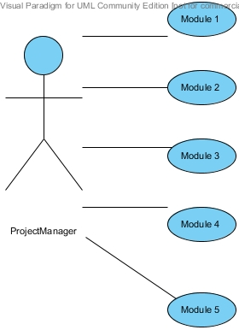
Design

Slide 6
Evaluation
Use blackbox testing to evaluate the system.

Slide 7
Conclusion
Some of the technical limitations are:
Workbreakdown structure
This system cannot remove the column that created.
This system to create hierarchy.
Monte Carlo Simulator
Graph issues
Cost Estimation
Checking not user friendly.
Data cannot be deleted after editing.

Slide 8
Conclusion
The application will be able to assist the project manager in getting the data required to produce a well-informed project charter.
Each module plays their part into creating a complete project charter.

